Slide 1
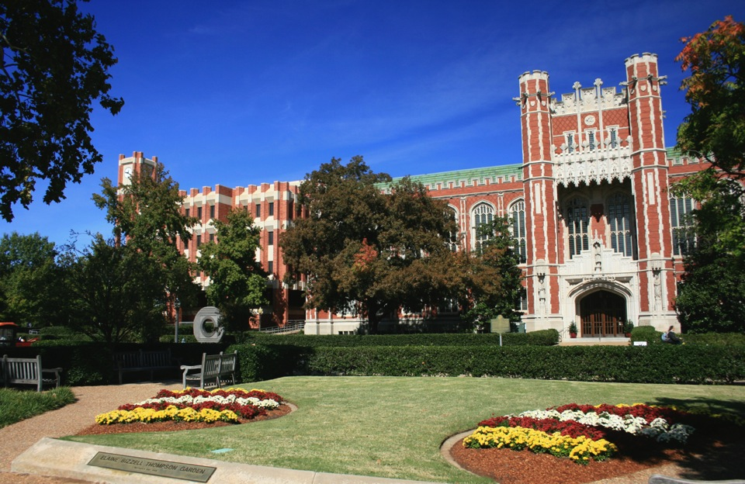
One Year Later at OU: Are We Wrangling, Managing or Maximizing Our Organizations' Research Data?
Mark Laufersweiler
Research Data Specialist
University of Oklahoma University Libraries

Slide 2
WHOAMI
Mark Laufersweiler
BS Physics, University of Kentucky
MS, PhD Meteorology, The Pennsylvania State University
Employment
Research Data Specialist
OU Libraries
Computer Systems Coordination (20+)
OU School of Meteorology
FSU Dept of Meteorology
DOE Atmospheric Radiation Measurement Program

Slide 3
Why we are here: data sharing
Office of Science and Technology 2013
Increasing Access to the Results of Federally Funded Scientific Research
Agencies with over $100 million research and development expenditures

Slide 4
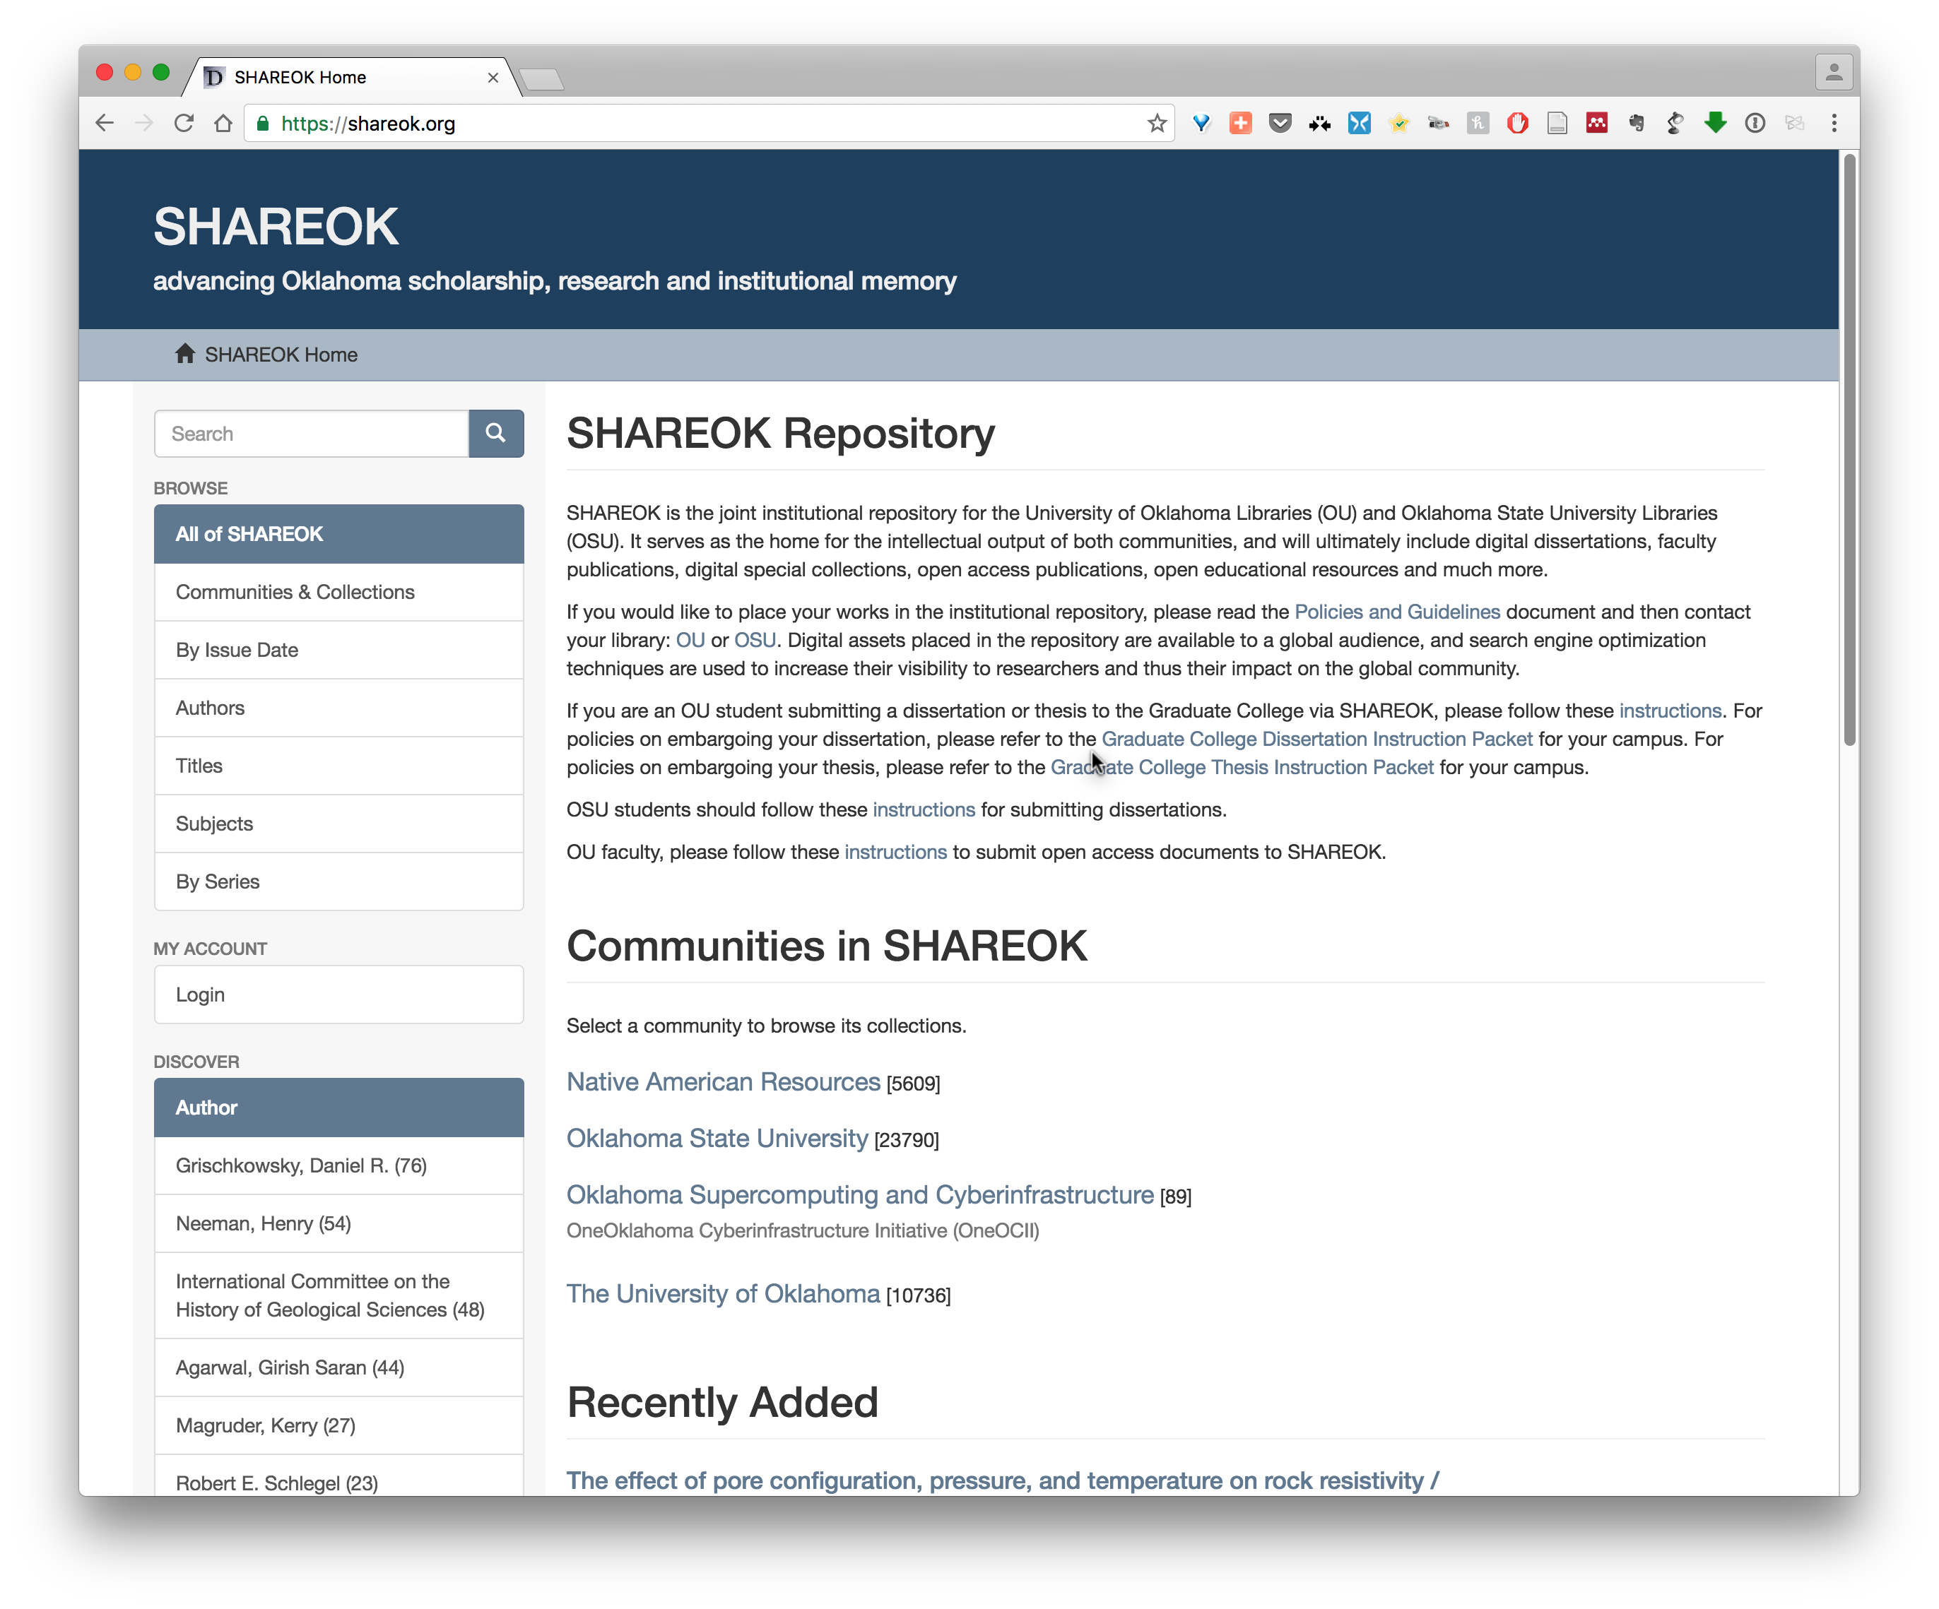
Institutional Repository
ShareOK
Primarily documents
Dissertation
Thesis
Publications
Faculty, staff, & student
Limited research data
Citizen Science
specimen sample photos
https://shareok.org

Slide 5
Education/training Workshops
Software Carpentry/Data Carpentry Foundation member
Software Carpentry 3 per semester
REU (Research Experience for Undergraduates)
Workshops in support of Oklahoma BioSurvey NRT grant
Research Data Management classes/hands-on
Tips, tricks, and tools
Workflow best practices
DMPTool (https://dmptool.org)
ResBaz (Research Bazzar)
Focuses on creating opportunities for researchers to share their digital skills
Two day event

Slide 6
Software/data Carpentry
Mission
To make researchers in science, engineering, humanities, and medicine more productive by teaching them basic lab skills for scientific computing.
Problem
Researchers spend more and more time building, using software
Most are primarily self-taught
Hard to measure how well they do things
But anecdotal evidence suggests "not very"

Slide 7
Software/data Carpentry
Solution
Scientists teaching scientists
Two days of hands-on learning
Multiple topics and domains
Software Carpentry
Data Carpentry
the Unix shell | ⇒ | automate repetitive tasks
Git & GitHub | ⇒ | track and share work
Python or R | ⇒ | build modular code
SQL | ⇒ | manage data
spreadsheets | ⇒ | Best practices
OpenRefine | ⇒ | Tidy Data, data cleaning
SQL | ⇒ | build modular code
Analytics & Visualization (R or Python) | ⇒ | Code provided for simple plots

Slide 8
RDM consultation
OU Faculty, staff, and students can schedule appointments with UL staff for DMP consultation
Liaison Librarians
Research Data Specialist
Digital Scholarship Specialists
Informatics Specialist
CLIR Fellowship postdoc (starting September)
open office hours @ Digital Scholarship Lab
Innovation HUB
Innovation @ EDGE
Virtual Reality
3D printing
Circuits

Slide 9
Scholarly Communications
Digital Identity
ORCID iD
Adoption increasing with publishers and large repositories
Integrations with
SCOPUS, CrossRef, ResearcherID
Dryad, PLOS
AGU, APS
UL and OU is an ORCID member
Integration with
ShareOK
Digital Object Identifiers

Slide 10
Scholarly IP
Digital Object Identifiers
DOI def: unique alphanumeric string assigned by a registration agency (International DOI Foundation) to identify content and provide a persistent link to its location on the Internet.
UL assists researchers with registering
South Central Climate Science Center (5)
OK Mesonet (3)
The Anthropocene Biosphere (21) symposium series
Promotes sharing of research output
Citable reference
Dataset authors/producers, data release date: Dataset title, version. Data archive/distributor, access date in standard AMS format, data locator/identifier (doi or URL).

Slide 11
Data Repository Need
Systems better suited for data formats
CSV, NetCDF, GRIBB, HD5, Excel, SQL
Systems to consider
CKAN/DKAN
IRODS
Build what community needs
Research Computing and Data Advisory Group
Survey
Data interviews
Use case based
Best practices

Slide 12
How is OU Libraries doing? A good start and more to do
Curatorial role for data stewardship
Establish a robust digital repository
Advocacy for open access and appropriate IP policies
Consulting services to the community regarding data management plans
New unit – not a traditional library but rather an information hub for research
Educational opportunities
Open access/copyright

